Slide 1

Connectivity
Performance Test Strategy

Slide 2
Table of Content
1. Performance Testing Overview - CLM
Architecture
Objective
Scope
Approach / Strategy
2. Performance Testing Overview – SRSGen4
Architecture
Objective
Scope
Approach / Strategy

Slide 3
CLM Architecture
MDE
CLM
CLM ADMIN
SDR
File Ingestion
File
Router
Dashboard
File Parser
CLM DB
File Receipt
Real-Time Lookup
EMC Customer sends file
Email
FEP
Business Obj Model
ESRS
Modem
Non-CLM Supported Files
Service Request
S360
FTPS
Filter Rules
SR Rules
SR Create/ Append
CLM RPT
Boomi
Lightning
FICO BOM
Isilon Storage
Rules Engine
MFT
RPT DB

Slide 4
CLM - Performance Testing Overview
Objective
Approach / Strategy
CLM stands for Connectivity Lifecycle Management where in the connectivity of the storage devices are checked by constantly pinging these devices.
The key objective of Performance Testing for CLM is to validate the changes being done in CLM file watcher, CLM file handler.
To check the response time of CLM reporting app scenarios especially Install Base, Connect Home & Service Requests Dashboards & benchmark for next target release.
To execute an 1 hour load test and send files through MFT Put functionality. There is mix of .json and .zip files which are sent to the CLM system with different transaction ids as in .json, .zip files.
CLM FEP
Files are being sent to CLM simultaneously from FTP as well as HTTP protocols in the 8:2 ratio.
The volume of the files which are being sent has been set as to match with the production volumes. Below are the per hour volume:
Component | Functionality | Voume (TPH)
File Processing | FTP | 64800
 | HTTP | 16200
Stop Filewatcher service on server clmftpprf01 in order to add 150k files during the stress.
Start Filewatcher service to allow the file transfer and start the execution with FTP & HTTP scripts.
Scope
  CLM apps Code Base Release Performance Testing included the following functionalities:
CLM RPT app
CLM FEP:
MAP_Product_Lookup : Dell product column and case management column
L-Dell Message Exchanges/Queues : CLM.M.BOM.DELL.Q, CLM.M.FILTERRULE.DELL.Q, CLM.PARSE.DELL.Q
CLM Reporting : query service tag, serial number, loader job changes to pull data
CLM RPT app:
UI Reporting scenarios: Connect Home, Install Base, Service Requests, Summary Page, Product Overview Page, Integrity Reports, IB details
To execute 1x load tests to determine the E2E response time, TPS for specified business transactions.
To monitor the PCF for perf environment logs and various metrics.
CLM MFT Dream Catcher
To determine the processing time for various config files like TOPO, EVENTS & SYSLOG of various products by MFT to CLM system.

Slide 5
CLM - Executive Summary
Transaction Performance:
CLM FEP
[Percentage of files which took >1000 secs to process should not be greater than 10% ~ 22.5 files per second, for continuous file flow]
5 hours
CLM RPT
Perform various search queries in order to fetch reports & check for 60 secs response times SLA
1 hour
CLM MFT
Upload Various Config Files & check the file flow with benchmark 1 minute SLA
1 hour
Metrics for CLM-FEP
Risks / Concerns:
Average processing time taken by files to process from the CLM system.
CPU utilizations and memory utilizations for the CLM queues.
Monitoring tools used:
To check queued messages – Rabbit MQ
Modules Memory Utilizations – JVM Memory
CLM Service CPU and memory Utilizations – JConsole
CLM FEP
Percentage of files which took >1000 secs to process should not be greater than 10% .
Files getting queued up in CLM queues should not be greater than 50k throughout the test duration.
CPU utilization for filter rule service should be less than 60%
Metrics for RPT
Processing time for various reporting dashboards in app.
Monitor the PCF for error logs, CPU user time, memory utilization, network latency & disk usage.
CLM RPT
Identify errors during search query, fetching reports.
Response Codes
User activity, Behavior analytics of servers
Metrics for MFT
Processing time for Config files and check the status.
CLM MFT
Benchmarked ART 1min for 81k file upload.

Slide 6
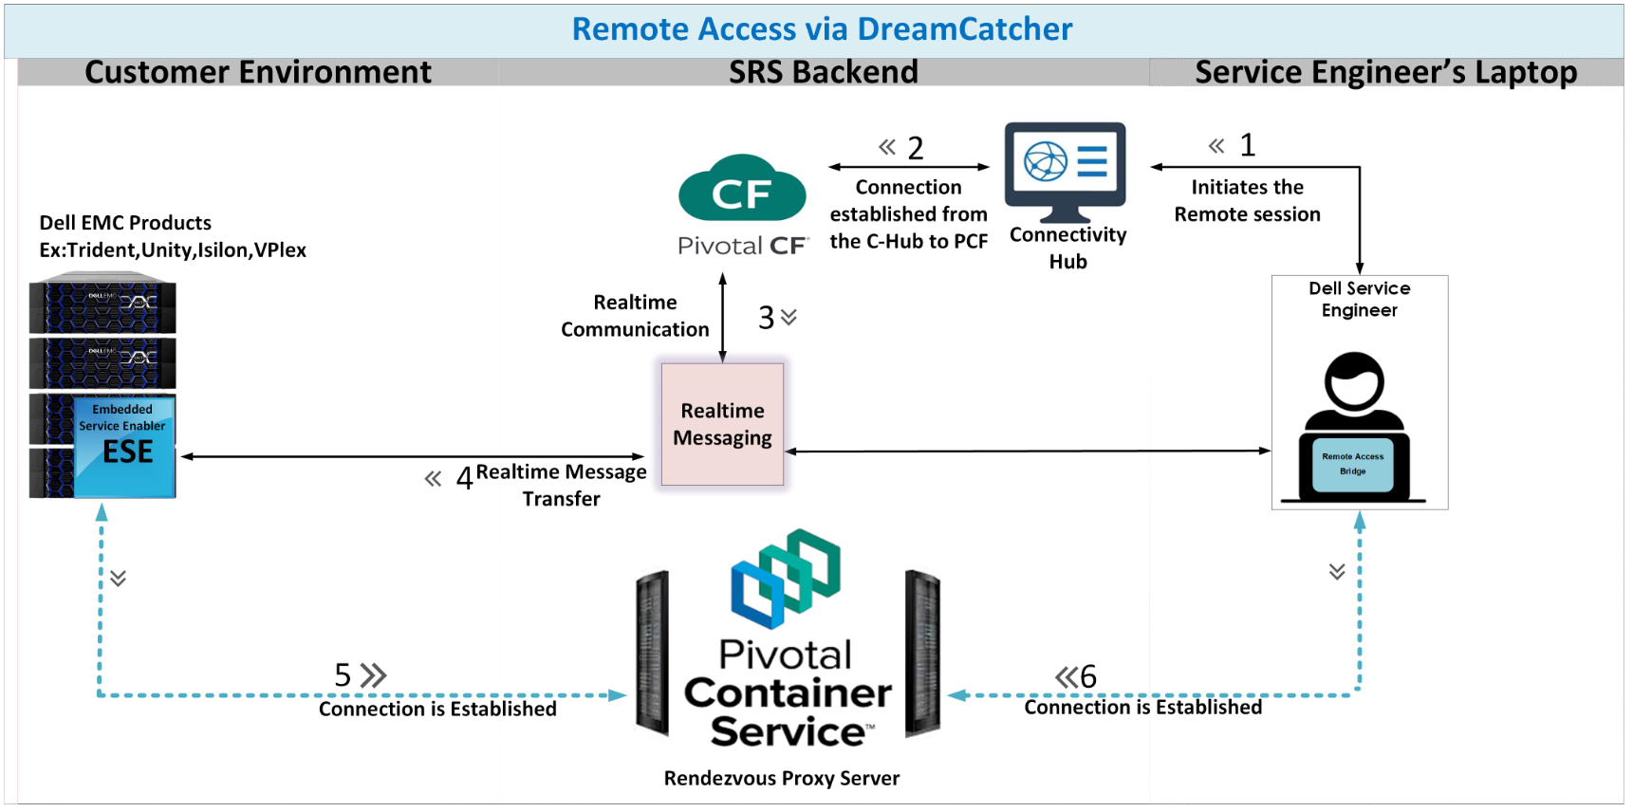
SRSGen4 Architecture

Slide 7
SRSGen4 - Performance Testing Overview
SRSGen4
Performance Requirement
SRSGen4 solution is primarily across ConnectivityHub portal replacing Service link and legacy MFT Portal.
Gen4 VE portal that removes Axeda agent dependency.
Gen4 Dell remote access helps to establish remote session capability to customer boxes via Connectivity HUB portal which is user driven.
Policy Manger – Permissions like Allow/Ask/Deny are set for operations performed on devices such MFT PUT, MFT GET, Remote Scripts, Remote Session.
4K concurrent users will be Logging in, perform 2 searches, then establish a remote session – stay active in the below trend and logout.
4K remote active remote session at any point in time.
60% of users – 60% of 4K = 2400 users – 5 mins remote session
30% of users – 30% of 4K = 1200 users – 10 mins remote session
10% of users – 10% of 4K = 400 users – 15 mins remote session
Volumes to be considered for Device Management services-
Add device – 1K requests per hour
Get device - 50K requests per hour
Update device – 10K requests per hour
Remove device – 1K requests per hour
Objective
The key objective of Performance Testing of Gen4 Testing is to check the performance of Connectivity Hub web interface by allowing concurrent load of 4000 Service Engineers to login and search for devices & establish a remote session on the devices.
To check response times of Connectivity Hub portal & VE Functionalities and benchmark the results for future releases.
To validate the performance of Connectivity Hub and VE during the Load tests.
Approach / Strategy
The 4K users load was simulated on Connectivity Hub portal with device management services running in parallel.
Load to be simulated from different geographical locations.
Systems/Interfaces monitored during the load test – Connectivity Hub, Mongo DB, Oracle DB and VE DB.
Load was simulated from USA Durham Load generators.
Transactions Average response times, 90th Percentile
Connectivity Hub, Remote Sessions, DTP, Device management PCF services – New-relic monitoring tool
Oracle DB – AWR report
Mongo DB – Percona Monitoring tool
VE DB – Shell script to monitor CPU and memory usage.
Scope
  Gen4 Performance Testing included the following functionalities:
Connectivity HUB functionalities :
Login
Search Capabilities - Search by SerialNumber/SiteID/Organization
Remote Sessions
File Transfer – Ondemand/ConnectHome Files
Device Management Backend:
Add/Get/modify/remove a device for a VE
VE-related Functionalities:
MFT PUT
MFT GET
Keep-Alive
Metrics

